Slide 1

Internship Studio DATA ANALYSIS Project
Mohammed FARHAN KHAN

Slide 2
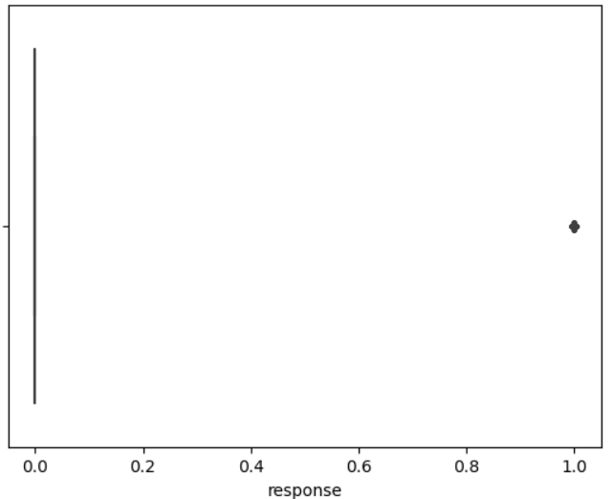
Response Plot

Slide 3
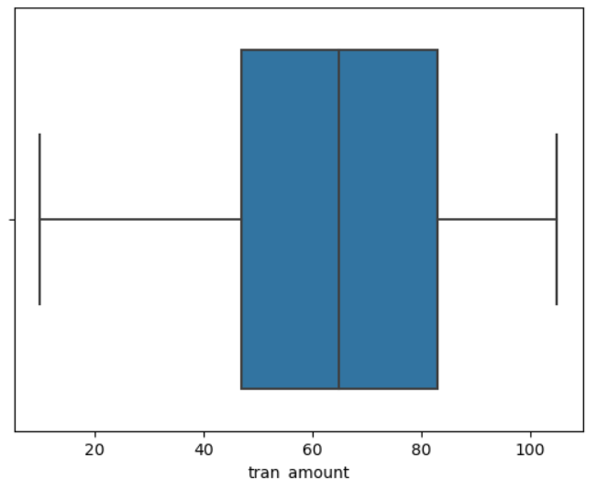
Transaction Amount Plot

Slide 4
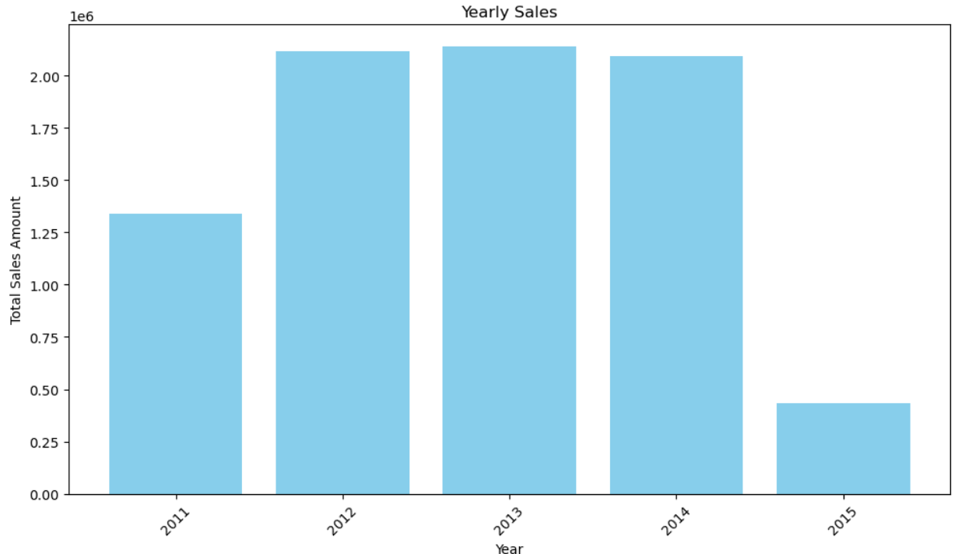
Yearly Sales

Slide 5
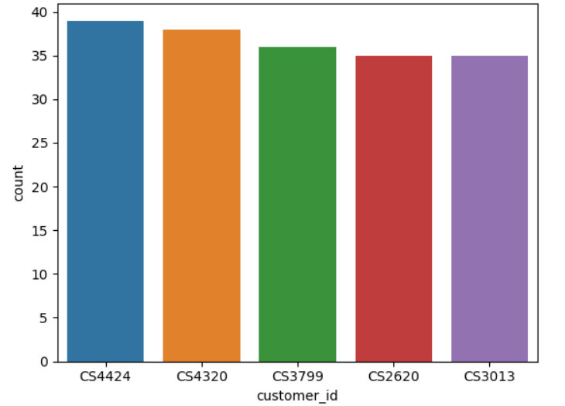
Top 5 Customers

Slide 6
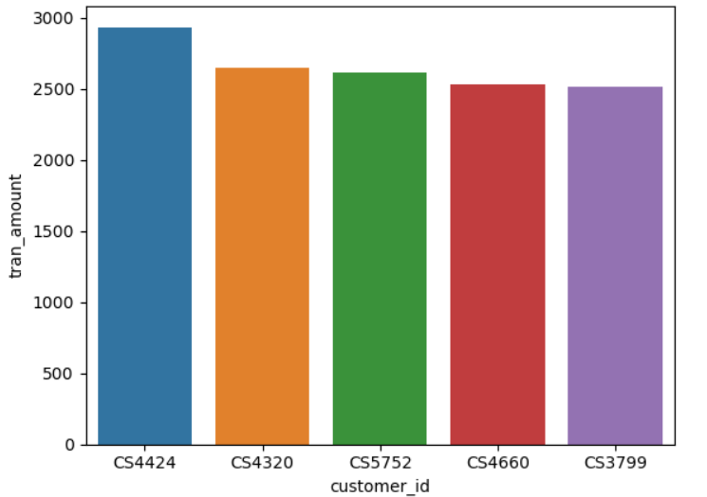
Top 5 sales

Slide 7
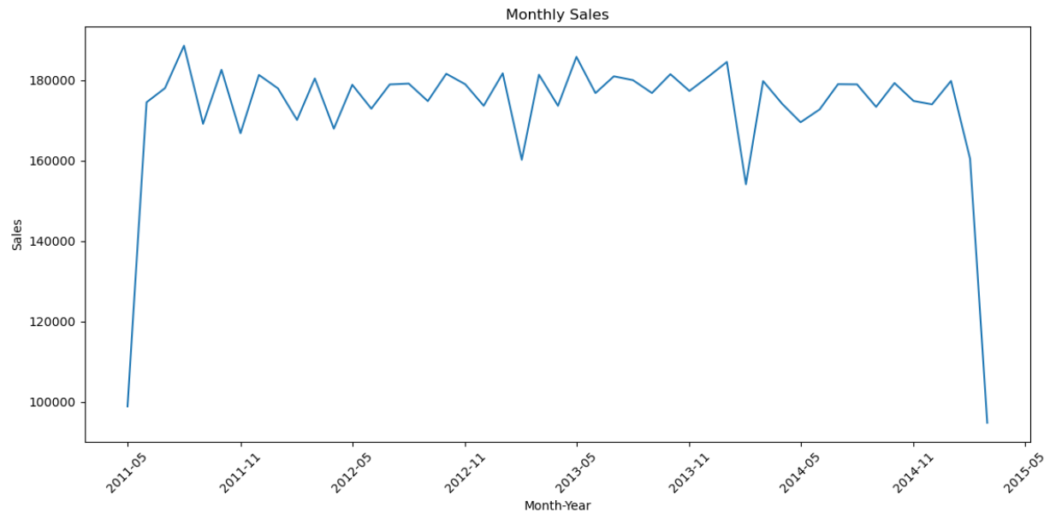
Monthly Sales

Slide 8
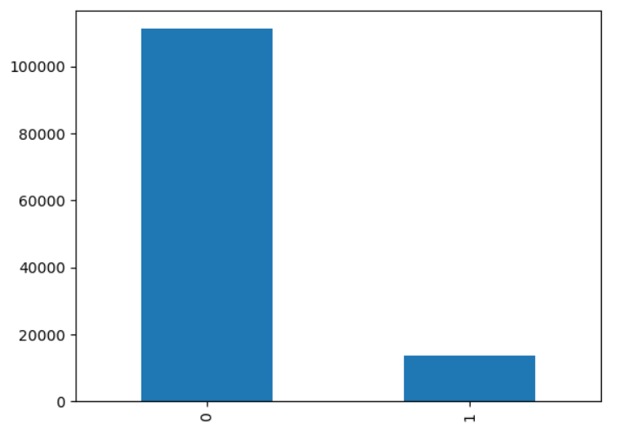
Churn Count

Slide 9
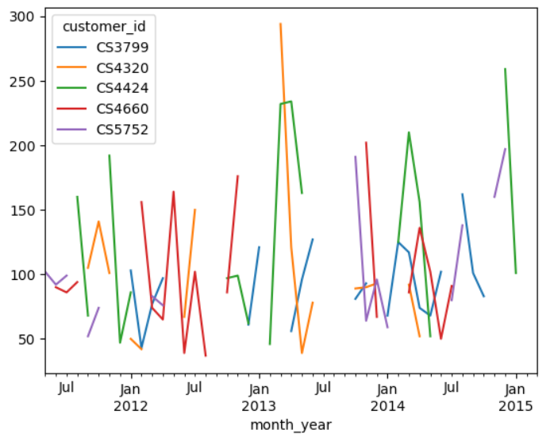
Analysis of Top Customers

Slide 10
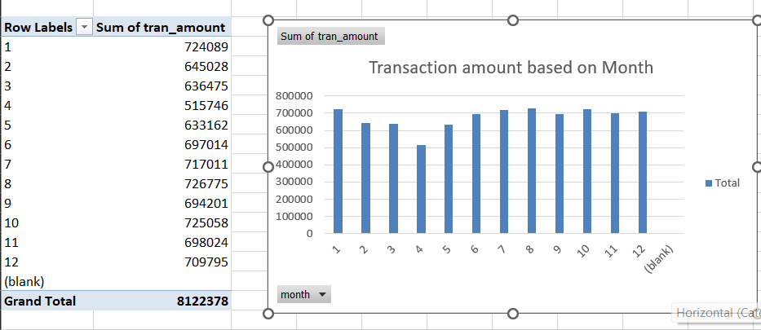
Transactions based on Month

Slide 11
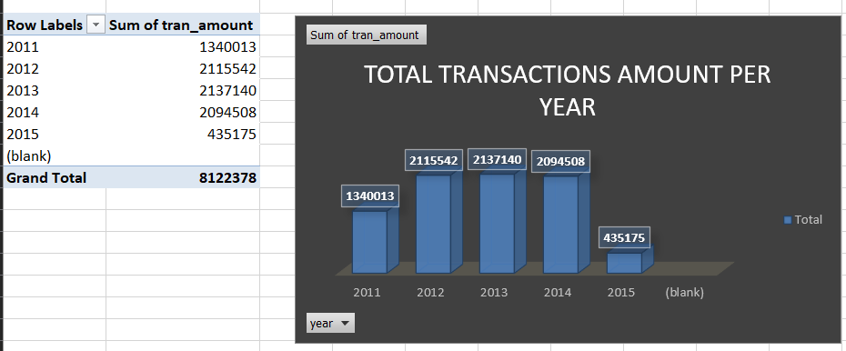
Total Transactions Per Year

Slide 12
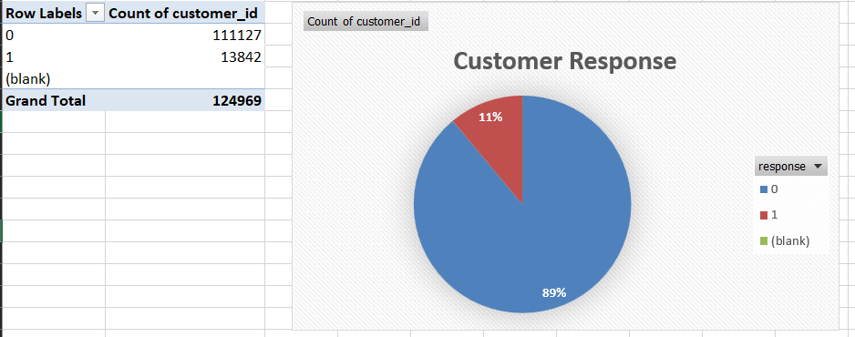
Customer Response

Slide 13
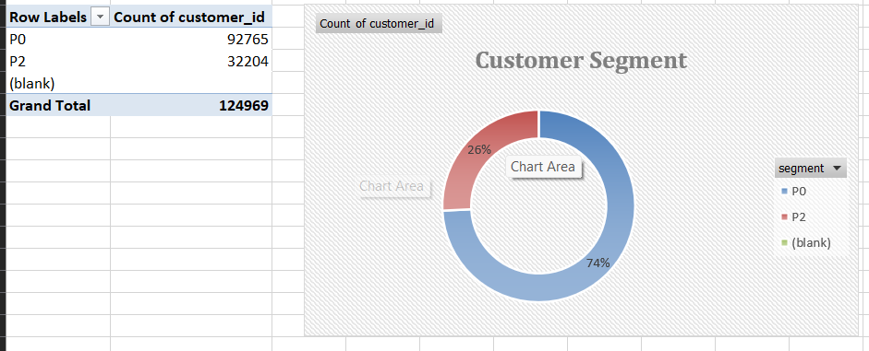
Customer Segment

Slide 14
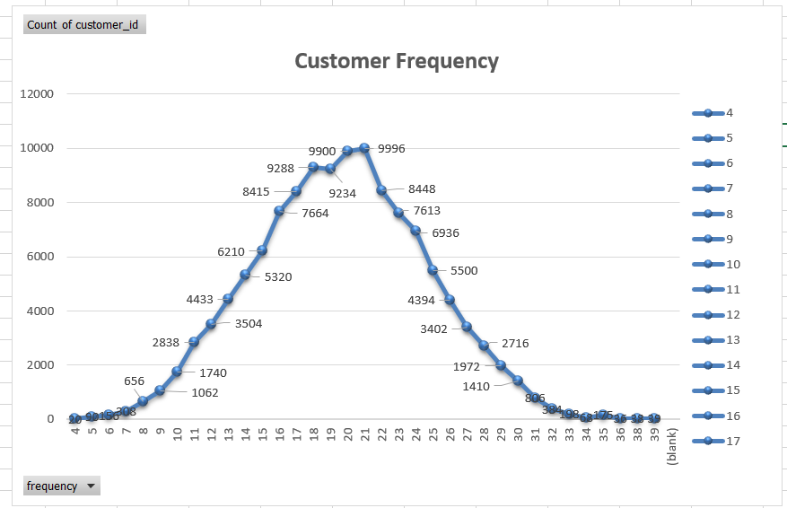
Customer Frequency

